Slide 1
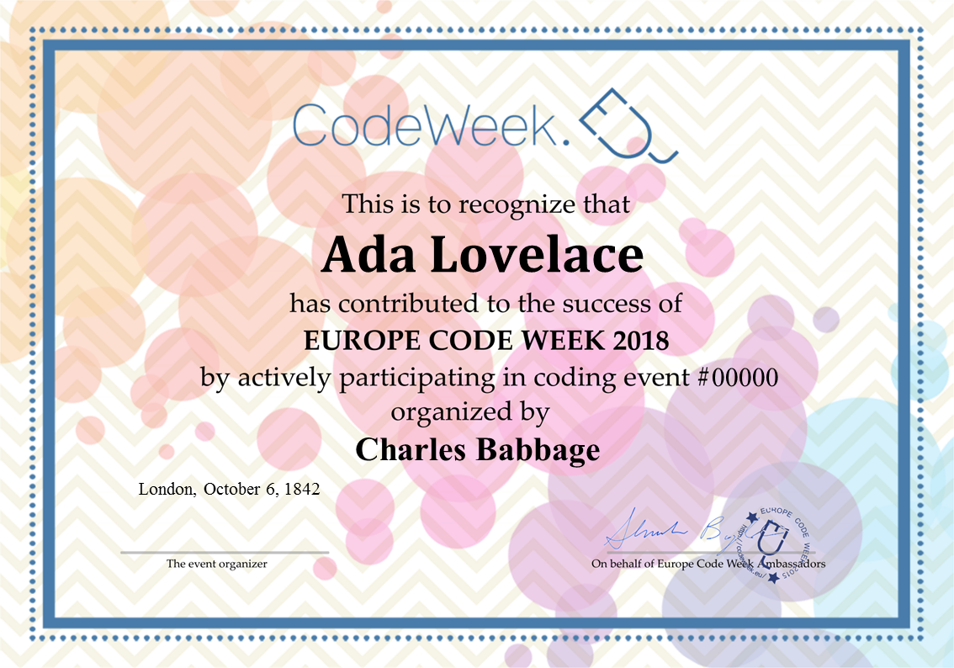
CERTIFICATES OF PARTICIPATION
This certification template has to be personalized and printed out by event organizers and teachers for their attendees and pupils. Personalize and replicate next page
Name of participant
Event number
Place and date
Event number
Signature

Slide 2
Ada Lovelace
00000
Charles Babbage
London, October 6, 1842

